Slide 1
Synergizing Optical Character Recognition: A Comparative Analysis and Integration of OCR Engines Individual Capstone Project Presentation
Presented by
Yuchen Li (SID: 490236424)
Supervisors:
Prof. Josiah Poon
Prof. Uwe Roehm

Slide 2
Agenda
Introduction - Background - Objective - Literature Review
01
Experiment - Methodology - Result - Discussion
02
Conclusion and Future Work
03

Slide 3
Background

Slide 4
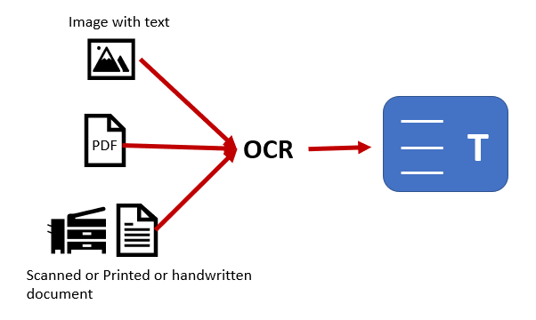
Optical Character Recognition
The process that converts an image of text into a machine-readable text format.

Slide 5
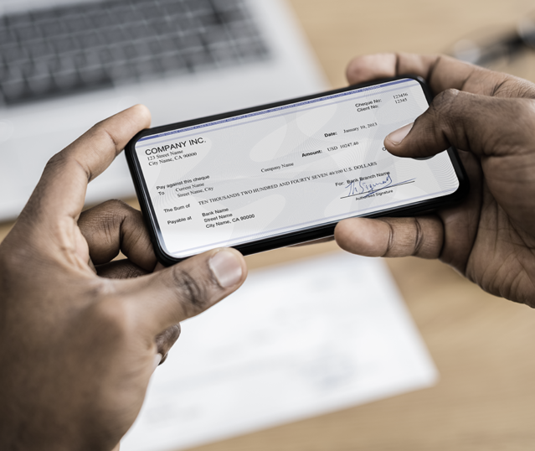
Importance and Application
Enhancing Accessibility: Digital records are easier to search, analyze, and cross-reference. Enhance the overall efficiency of operations.
Historical and Archived Data: Crucial for historical accuracy, demographic studies, and geographic research. Reduce the decision-making error.
Cultural and Historical Preservation: Preserving and digitizing historical handwritings will promote historical research and education.
Notes:
Enhancing Accessibility: First of all, OCR is important for enhancing the data accessibility, for example retail sectors will receive tons of transactional documents in paper such as invoices, receipt and bills. With the help of OCR, they can make those information easier to search, analyze, and cross-reference, enhancing the overall operational efficiency.
Historical and Archived Data: many government current and historical documents (such as birth and death registries, marriage licenses, and land deeds) largely exist in paper as well. With the help of OCR, it’ll be easier to conduct demographic studies, and geographic research. These will be a great aid in reducing the decision making error for the future urban planning and development.
Cultural and Historical Preservation: last but not least, Handwritten documents often hold cultural and historical significance. Preserving and digitizing them allows for the maintenance of cultural heritage, promoting historical research and education.

Slide 6
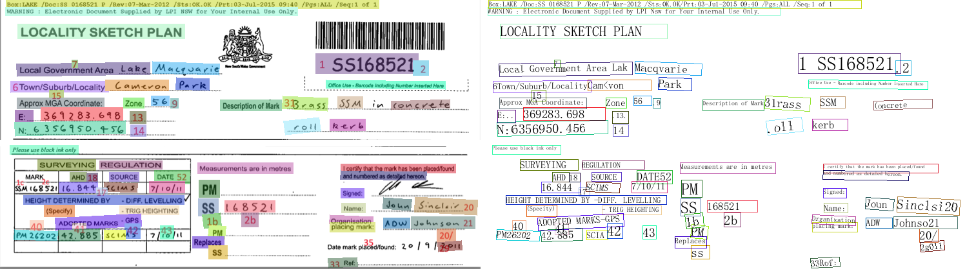
Example
2
2
1
1
Missing values caused by fail to detect
Spelling Error caused by hand-writings
Notes:
Let me give a brief example of what the OCR is capable of. The OCR engine used in this example is paddle OCR.
On the left, we have the image we want to digitalize, the OCR system firstly detect where the texts are (which is identified by the color). Then it starts to recognize in those detection boxes. The visualization of the output is the one on the right. You can tell that it captures most of the important information, but it has few issues like:
Missing values caused by fail to detect
Spelling Error caused by hand-writings
I’m sure there are more issues to find if we look closer. So this leads to the objective of my research

Slide 7
Objective

Slide 8
The aim is to Improve and compare Tesseract OCR, Keras OCR, Paddle OCR and Microsoft Azure OCR performance under various image quality, text structure, and fonts
Explore the performance of OCR models incorporating different image pre-processing approaches.
Compare and identify most accurate and robust OCR model on complex layout, low quality and hand-writing font images
Develop an integrated scoring system that synergizes individual outputs to generate the most accurate and robust result.

Slide 9
Literature Review

Slide 10
OCR Engines
Tesseract OCR-- A Multifaceted Tool with Language Versatility: Study conducted by Ray Smith[20]
Pros: adaptability and accuracy in processing printed text.
Cons: its performance is expected to be heavily dependent on the input image quality.
Keras OCR -- Customizability at the Expense of Efficiency: Study by Madhugiri and Devashree[12]
Pros: it excels in image text extraction and has a high level of customization flexibility.
Cons: its processing speed is somewhat mitigated by the extensive computational resources required, particularly evident in real-time processing scenarios.
Notes:
Tesseract OCR: A Multifaceted Tool with Language Versatility: Study conducted by Ray Smith[20], have consistently highlighted its adaptability and accuracy in processing printed text. However, its performance is expected to be heavily dependent on the input image quality.
Keras OCR: Customizability at the Expense of Efficiency: study by Madhugiri and Devashree underscores the trade-offs in Keras OCR [12] While it excels in image text extraction, its processing speed is somewhat mitigated by the extensive computational resources required, particularly evident in real-time processing scenarios.

Slide 11
OCR Engines
Paddle OCR -- Speed and Efficiency in Text Style Recognition: Study by Liu et al. (2020)[3]
Pros: its ability to quickly process and recognize a diverse array of text styles. Particularly effective in applications where text presentation varies significantly.
Cons: restricted language support and a relatively smaller community base
Microsoft Azure Computer Vision -- Out-of-the-Box Usability with Ecosystem Dependence: Study by William Ughetta and Brian W. Kernighan[21]
Pros: Its ready-to-use and scalable capabilities, which necessitate minimal setup, making it ideal for rapid deployment
Cons: its potential reliance on the broader Microsoft ecosystem, which might impose limitations on its utility in non-Microsoft environments.
Notes:
Paddle OCR: Speed and Efficiency in Text Style Recognition: Evaluation by Liu et al. (2020), Paddle OCR’s proficiency lies in its ability to quickly process and recognize a diverse array of text styles [3]. This makes it particularly effective in applications where text presentation varies significantly. its limitation surfaces in the form of restricted language support and a relatively smaller community base
Microsoft Azure Computer Vision: Out-of-the-Box Usability with Ecosystem Dependence:
As appraised by William Ughetta and Brian W. Kernighan [21], the strength of this tool lies in its ready-to-use capabilities, which necessitate minimal setup, making it ideal for rapid deployment in diverse environments such as IoT and enterprise solutions. The flip side of this convenience is its potential reliance on the broader Microsoft ecosys- tem, which might impose limitations on its utility in non-Microsoft environments or applications requiring extensive customization outside the Microsoft suite.

Slide 12
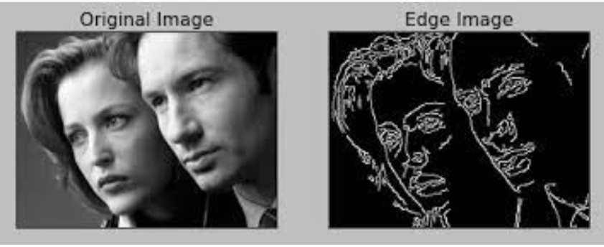
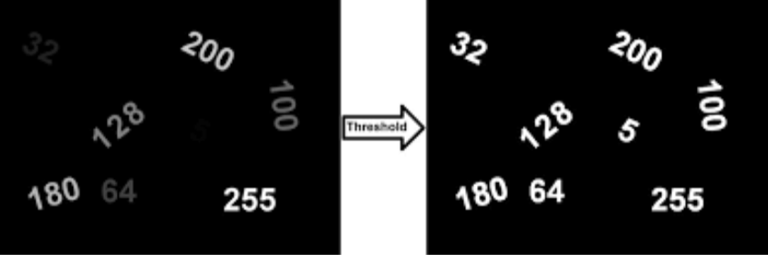
Image Preprocessing
Image Edge Detection
Image Thresholding
Study by by Wu et al. (2017)[24] shows:
Effective in enhancing OCR text recognition on ICDAR2013 dataset
Sensitive to Noise which leads to the false detection of edges
Study by Gupta et al. (2007)[5] shows:
Thresholding solves lighting and contrast inconsistencies.
Generate a clear delineation between text and background

Slide 13
Methodology

Slide 14
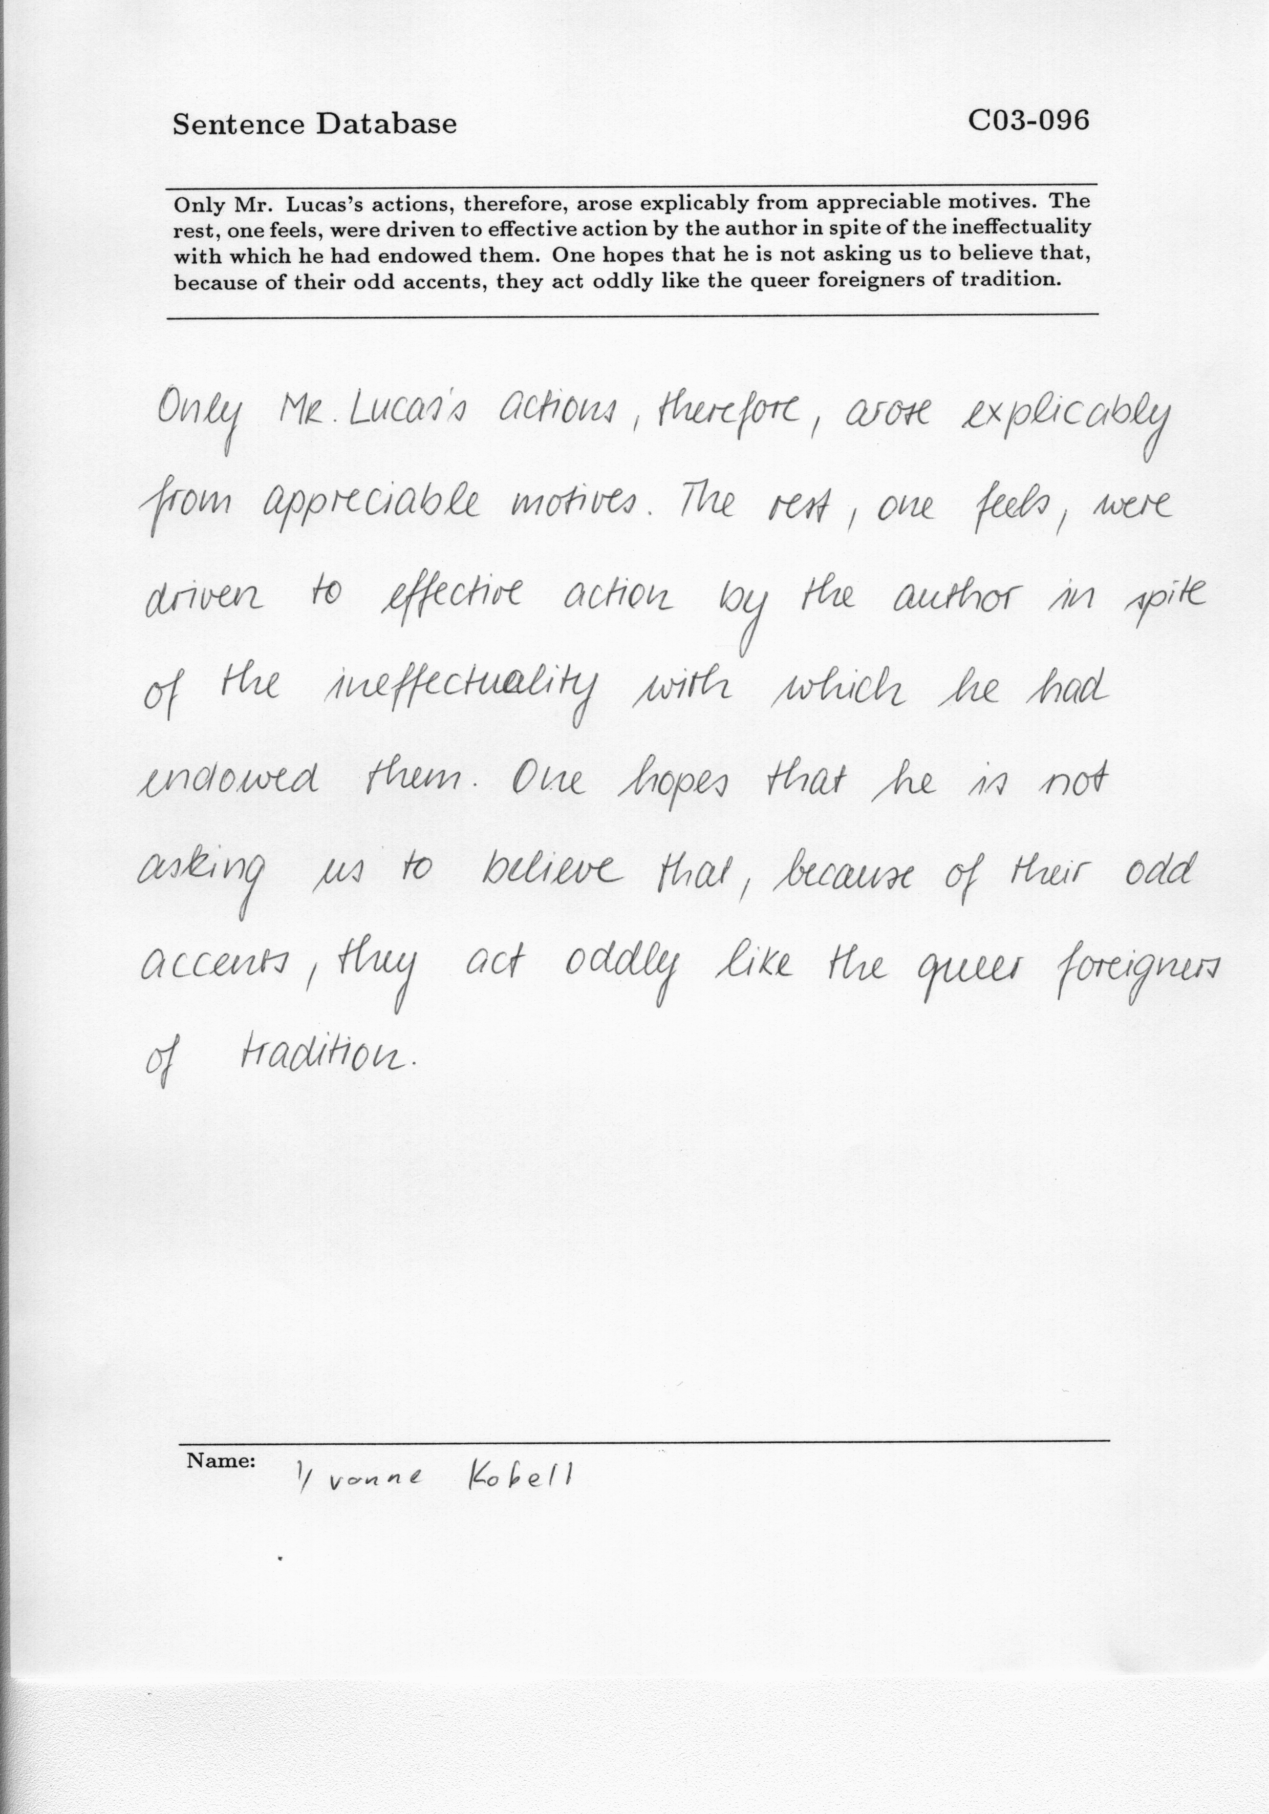
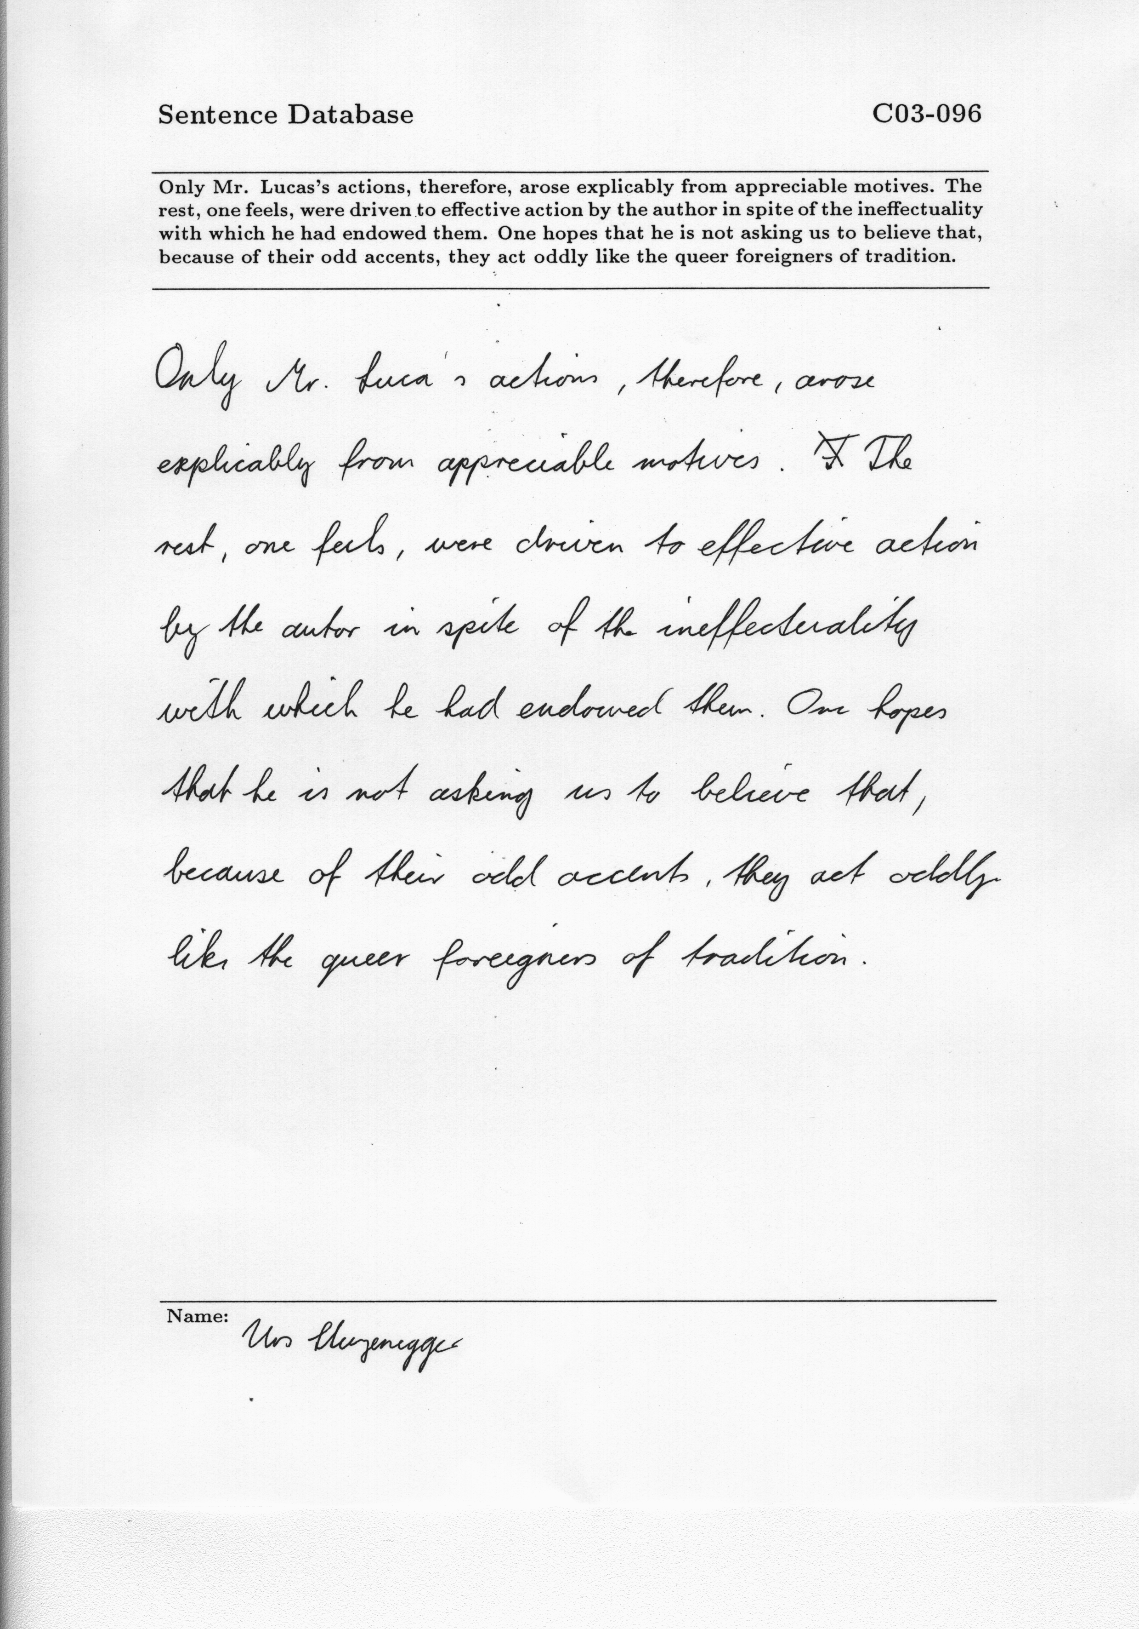
Dataset -- IAM
IAM Database Group at the University of Bern by Marti and Bunke
Various handwriting styles and Simple layout
Tested 106 images to evaluate proficiency in recognizing handwritten text.
Notes:
The efficacy of OCR systems hinges significantly on the datasets used for their evalua-tion. In this study, two distinct datasets are employed: the IAM Dataset and the FUNSD Dataset.
The IAM dataset, Developed by the IAM Database Group at the University of Bern by Marti and Bunke, contains forms written by numerous writers, offering various handwriting styles. The text within the dataset is sourced from the Lancaster-Oslo/Bergen Corpus, ensuring a wide range of vocabulary and sentence structures.
Thus it’s a solid foundation for testing and showcasing OCR engines’ capability to recognize hand-writings in the real world.

Slide 15
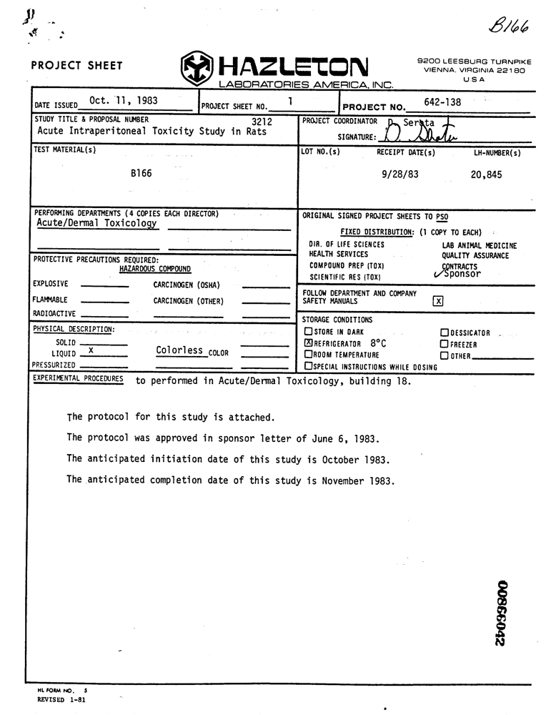
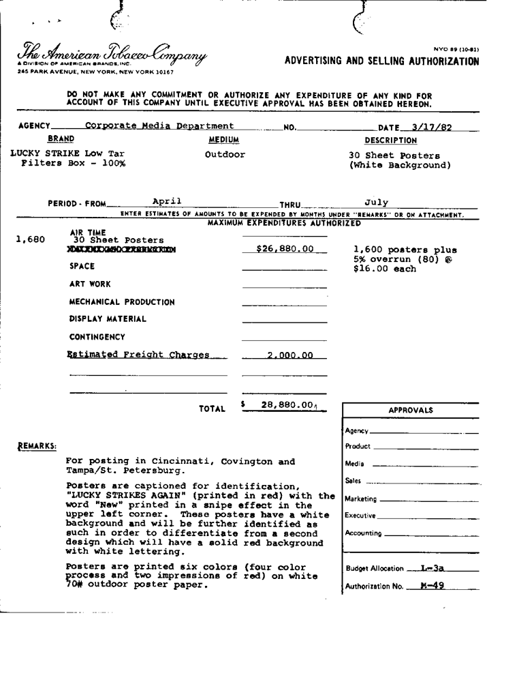
Dataset - FUNSD
Form Understanding in Noisy Scanned Documents
Blurry image quality and Complex text layout
Tested 50 images to evaluate proficiency in form understanding
Notes:
FUNSD is short for Form Understanding in Noisy Scanned Documents. The name is self explanatory. FUNSD is designed for the task of form understanding, comprises scanned images of noisy, unstructured forms.
You can see from the example that it has various form structure and layout and it also has low quality averaging around 100 dpi. This was expected and later proven by the experiment that OCR models especially Tesseract do not perform well for images below 200 dpi.

Slide 16
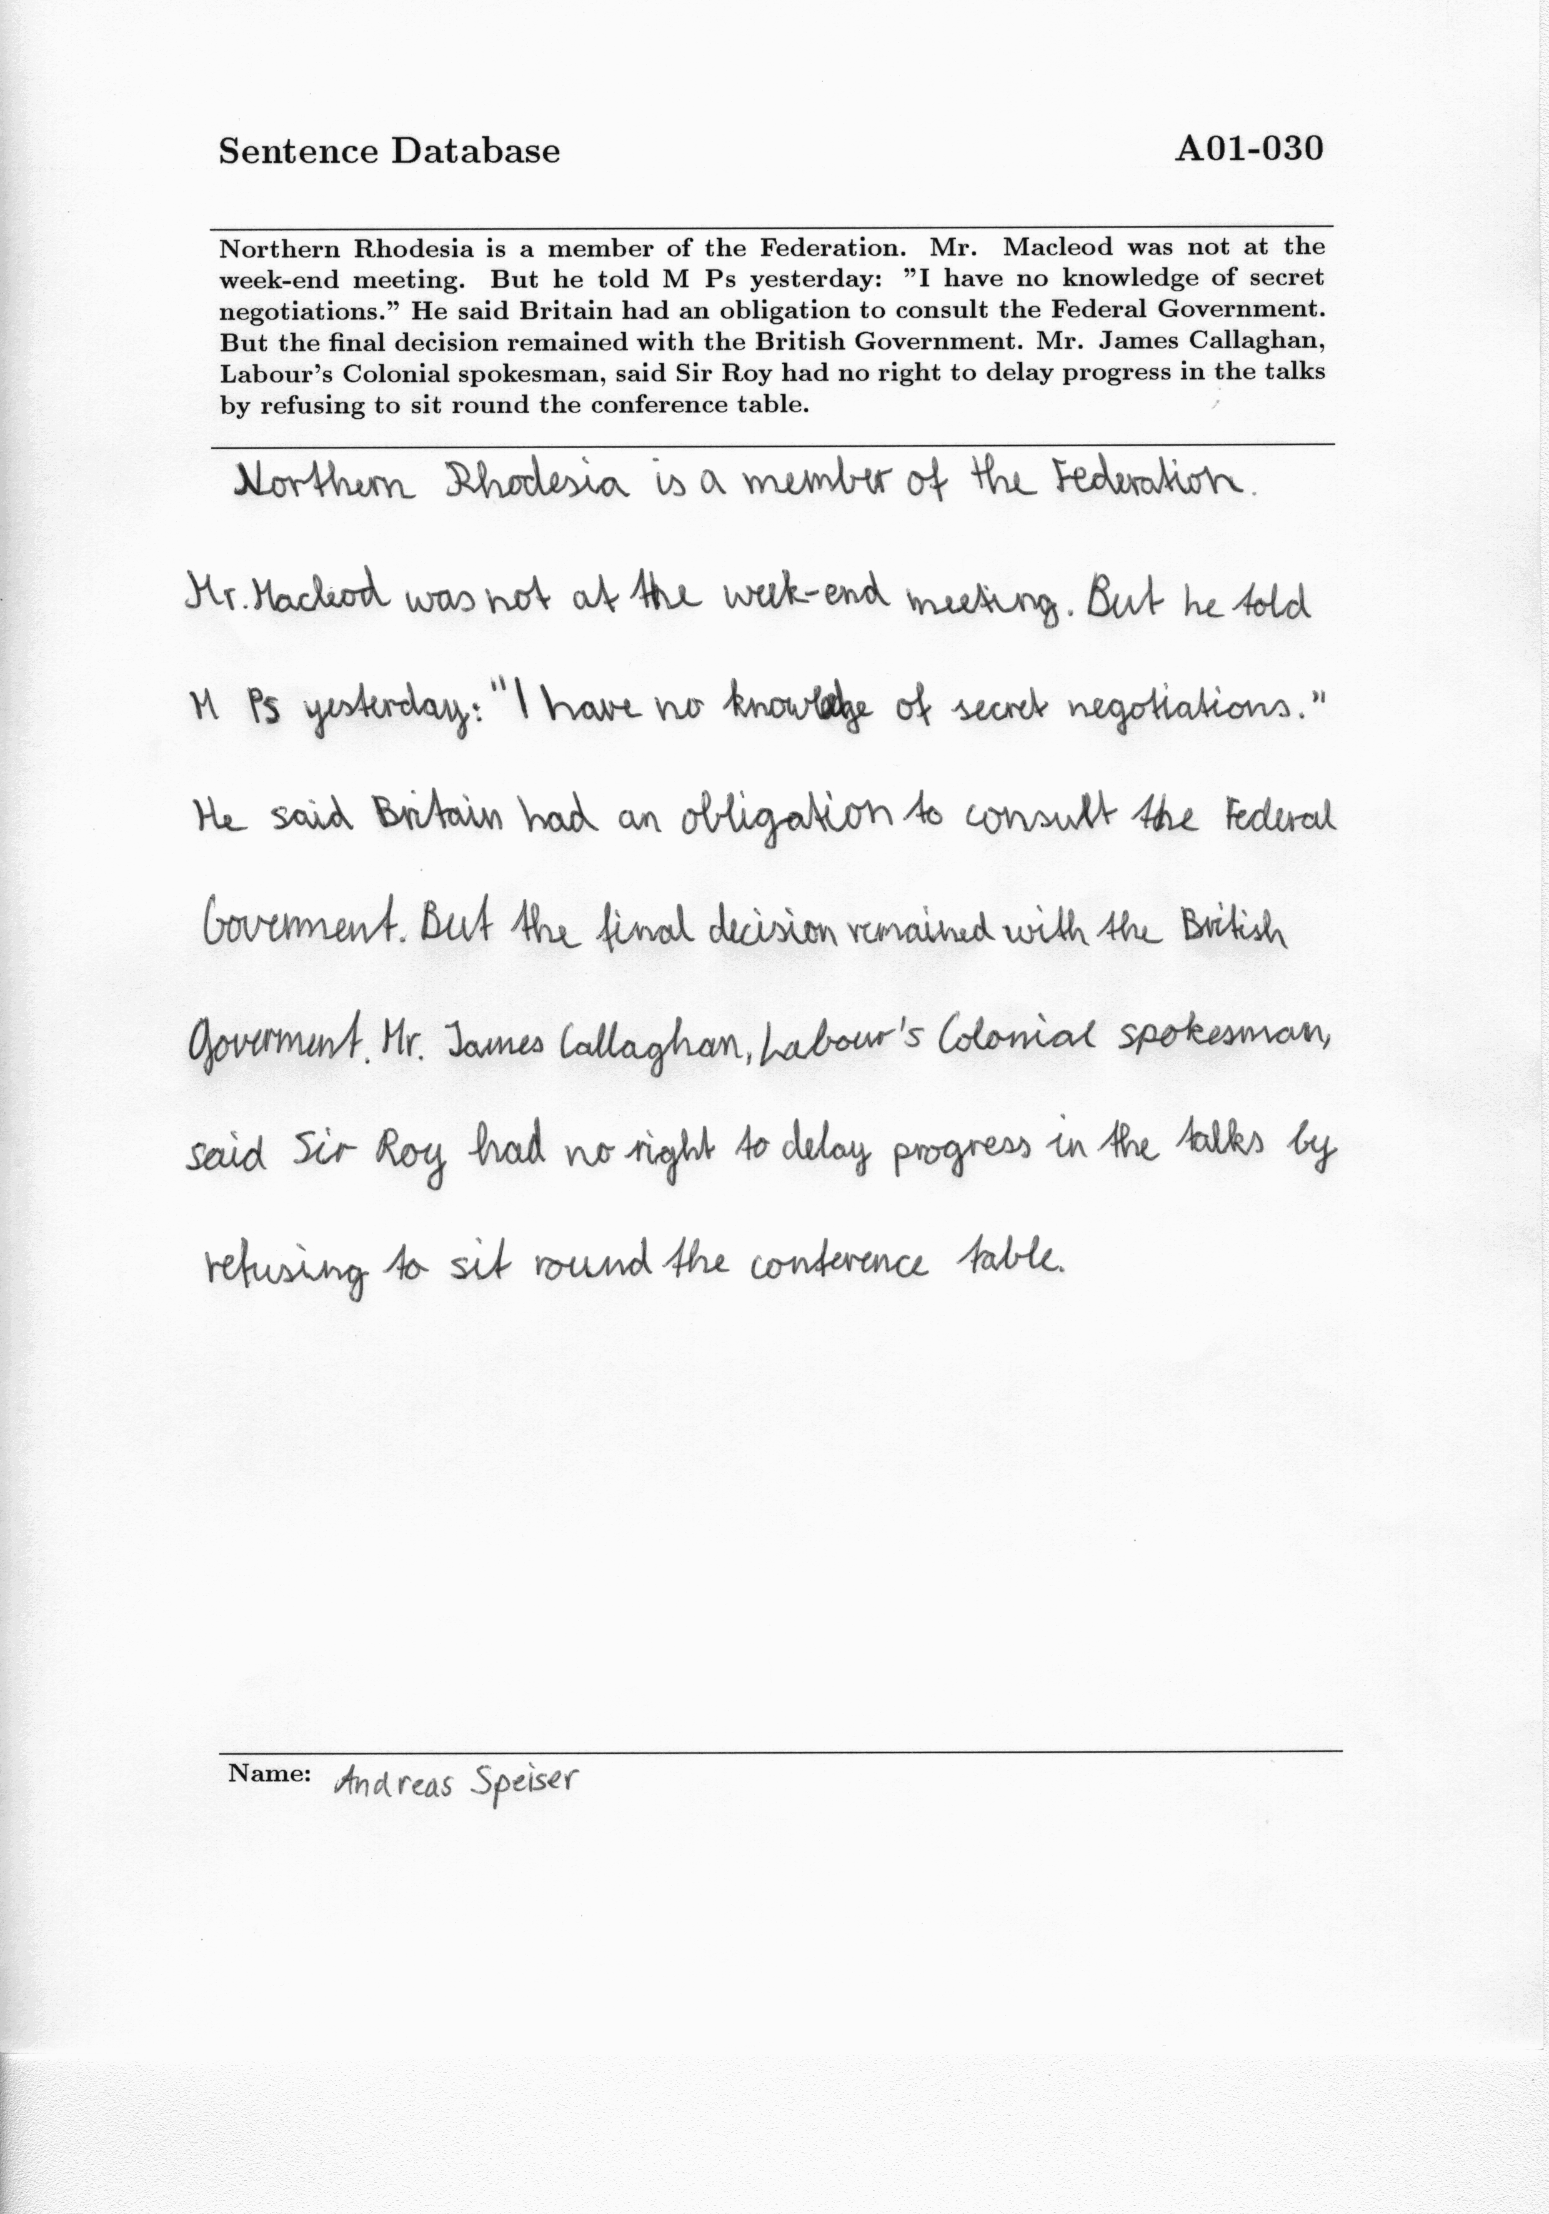
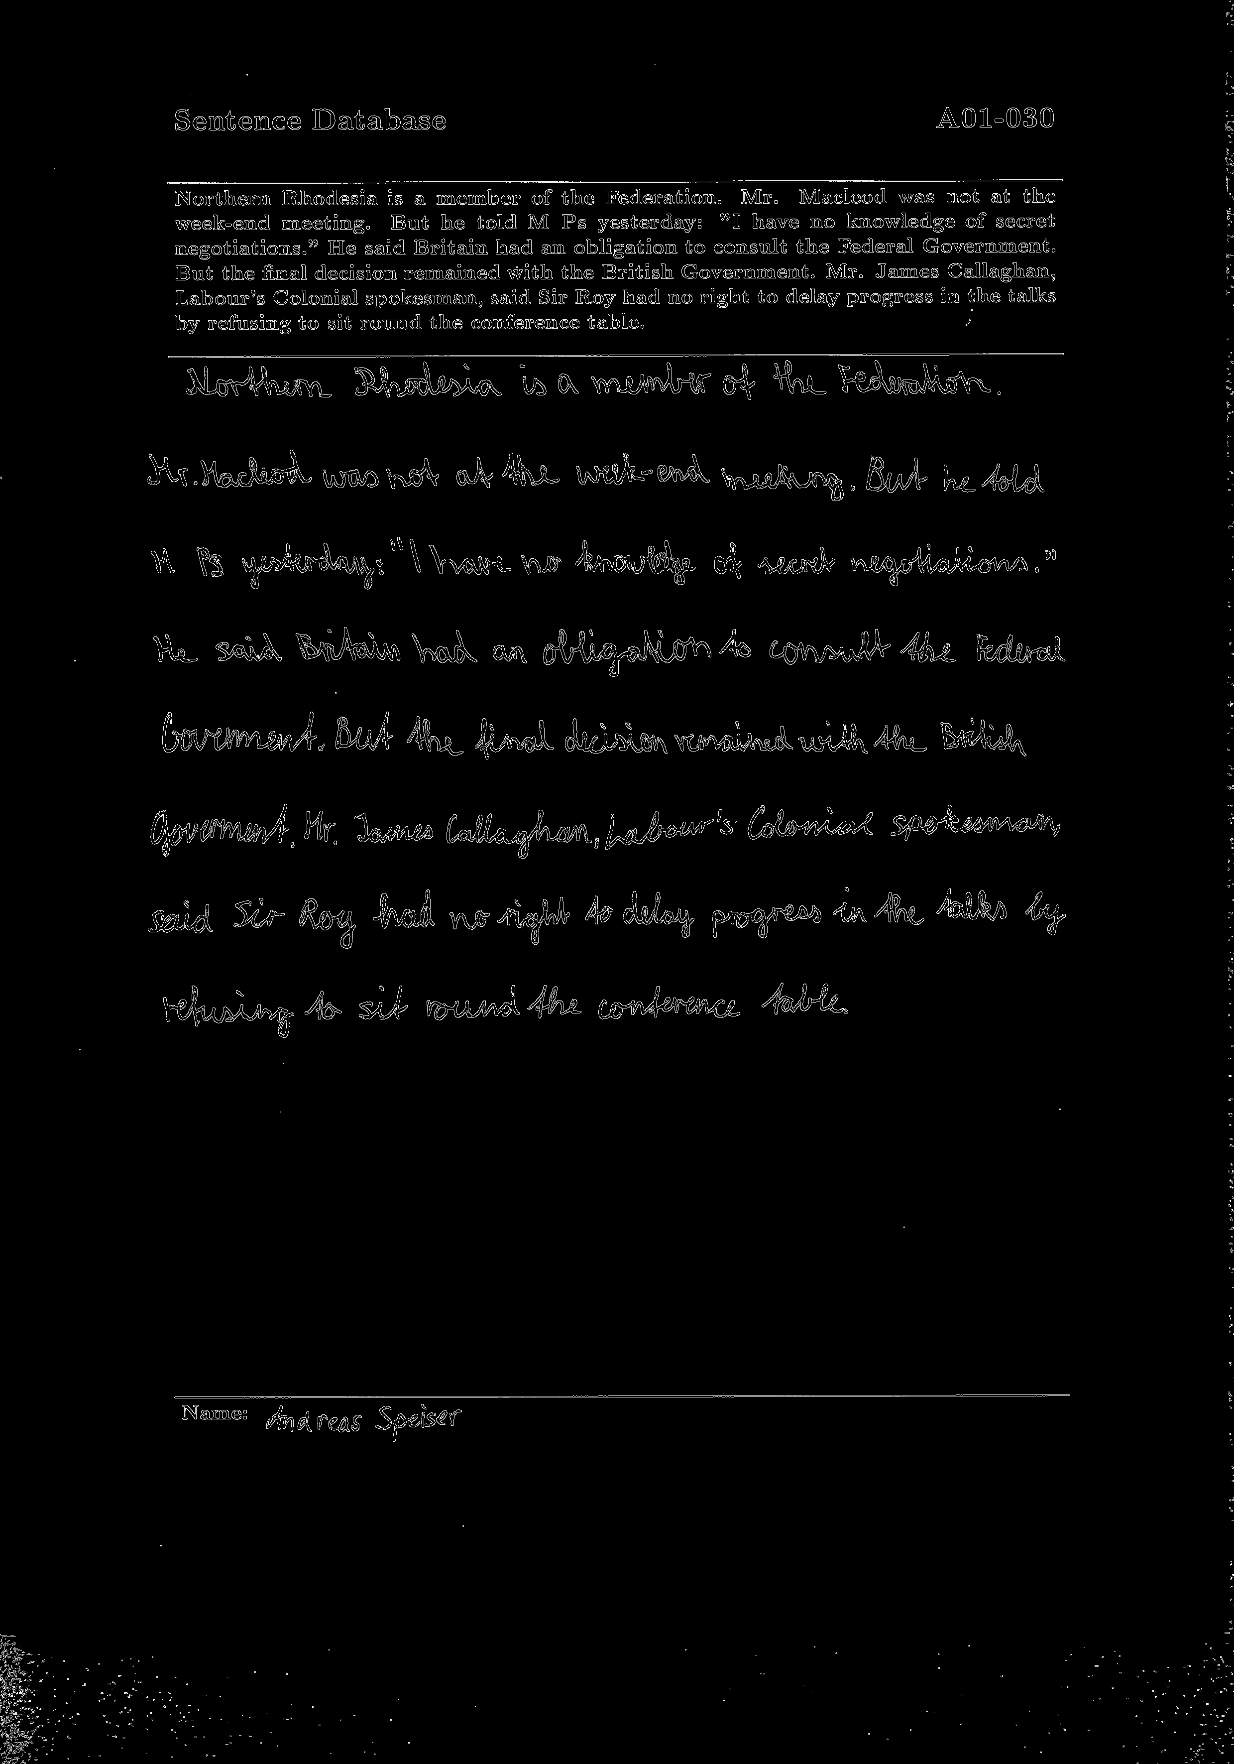
Data Preprocessing – Canny Edge Detection
Helps in reducing noise and irrelevant details.
Helps to isolate cursive or connected characters from the background and each other.
Two threshold parameters are set to 100, 200 respectively
Notes:
Canny edge detection includes a stage of smoothing with Gaussian filter. Helps in reducing noise and irrelevant details.
Edge detection helps to isolate characters from the background and each other in the case of cursive or connected scripts.
The Canny Edge Detection is parameterized by two threshold values that govern the detection of edges, set at 100 and 200 respectively in this instance. The selection of these thresholds is critical, as it influences the sensitivity of the edge detection process. A lower threshold may result in the detection of spurious edges, while a higher threshold may overlook significant yet subtle edges.

Slide 17
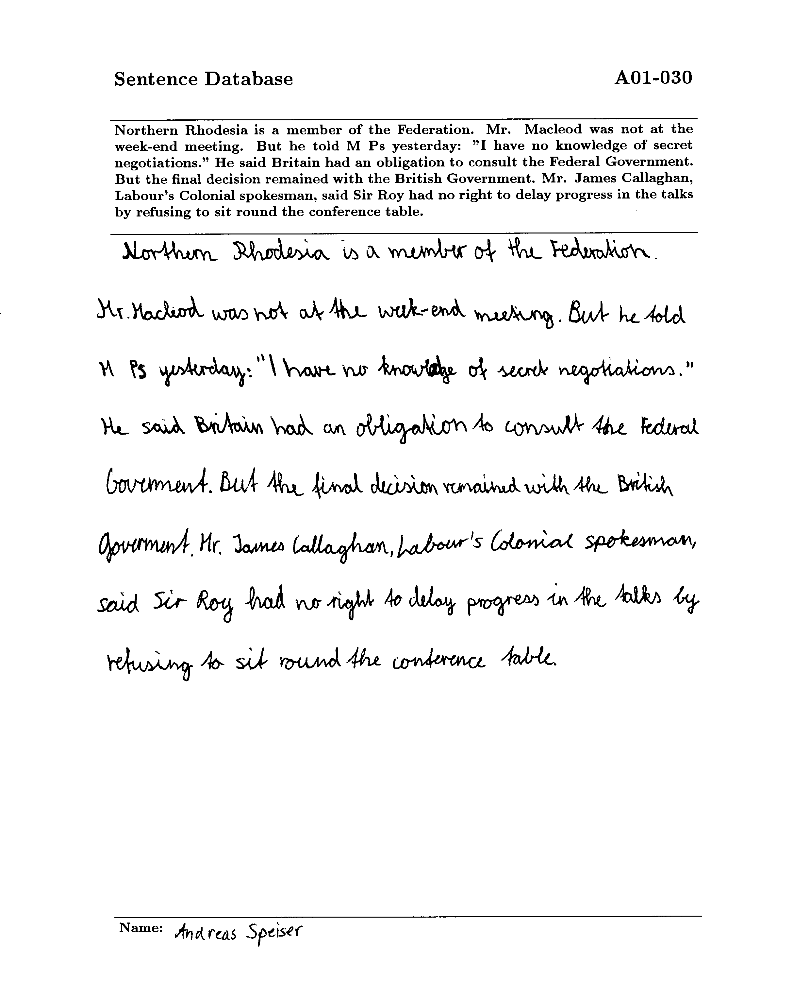
Data Preprocessing – Otsu’s Thresholding Method
Automatically determines the optimal threshold value
Increase contrast. Make the text more distinct from the background
Reduce the computational complexity for OCR system
Notes:
Upon loading an image in grayscale, the ’cv2.threshold’ function is invoked with the flag ’cv2.THRESH_BINARY’ and ’cv2.THRESH_OTSU’. The former flag indicates the binary nature of the thresholding process, while the latter automatically determines the optimal threshold value based on the bimodal histogram of pixel intensities, a distin- guishing feature of Otsu’s algorithm.

Slide 18
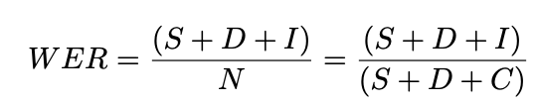
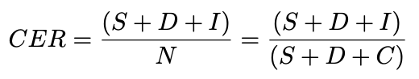
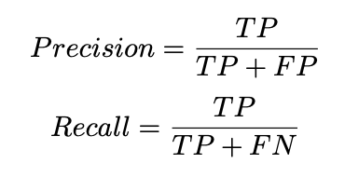
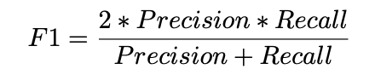
Evaluation Metrics
WER & CER: Calculated based on the number of errors (substitutions, deletions, and insertions) made compared to ground truth.
F1: Robust measure of general performance
Precision and Recall: Measure the false positive (FP) and false negative (FN)
Running Time: Measures the average processing time OCR spent on each image
Notes:
In this experiment, I applied Accuracy, Precision, Recall, F1, WER and CER as my performance evaluation metrics.
Word Error Rate (WER) is a critical metric in this context, calculated based on the Levenshtein distance, but at the level of words. They are aiming to solve the challenge in evaluating OCR performance when the length of the word recognized by the system differs from that of the ground truth, which is assumed to be correct. A lower WER is indicative of better recognition performance, with few errors detected.
CER is a more nuanced evaluation, aiming to solve the issue existed in WER particularly when an entire word is deemed incorrect due to a single letter’s error.
While WER and CER provides a quantitative measure of error, it does not offer insights into the specific nature of these errors. Thus Precision, Recall and F1 score is used to provide a further analysis. F1 Score is the weighted average of Precision and Recall, It takes both false positives and false negatives into account and thus making it a more robust measure than accuracy. Sometimes F1 score alone might seem high, but it could be due to a very high recall but low precision which in the real-world cases may not be ideal.

Slide 19
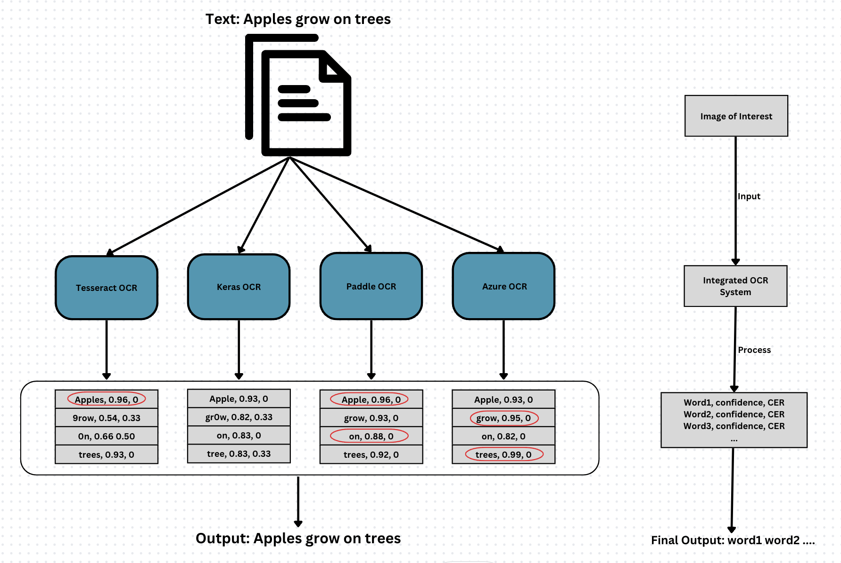
Integrated Scoring System
OCR Processing: Each OCR engine processes images as normal with outputs that contains confidence score and CER.
Assessment:
Analyze CER and Confidence Score to determine the most viable output. If CERs are the same, confidence score is the second measure.
If an engine typically has lower CER for certain types of text (like numbers or special characters), give more weight to its output in those cases.
Output: Combine the most reliable parts from each engine's output based on confidence scores and error rates.
Notes:
The flowchart depicts the operational workflow of an integrated OCR scoring system designed to process a given text from an image. Firstly, an image containing the text "Apples grow on trees" serves as the input. The image is then simultaneously processed by four different OCR engines: Tesseract OCR, Keras OCR, Paddle OCR, and Microsoft Azure Computer Vision. Each OCR engine analyzes the image and provides its output, along with a confidence score and a Character Error Rate (CER) for each word detected.
For example, Tesseract OCR identifies "Apples" with a high confidence of 0.96 but mistakes "grow" for "9row" with a lower confidence and CER. Keras OCR recognizes "Apple" without the ’s’, and similarly has varying confidence levels and CERs for other words. Paddle OCR correctly identifies "Apples" and "grow" with high confidence and has lower CERs. Lastly, Azure OCR shows high confidence and low CER for most words, with "trees" having the highest confidence at 0.99.
The outputs of all OCR engines are then aggregated and passed on to the integrated scoring system to evaluate each word based on the provided confidence scores and CER from each OCR engine. If an OCR engine consistently performs well on certain types of texts, more weight is given to its output in the scoring process. The final output is a string of words that have been selected based on the highest score from the aggregated results, aiming to form the most accurate rendition of the text from the image.

Slide 20
Result and Discussion

Slide 21
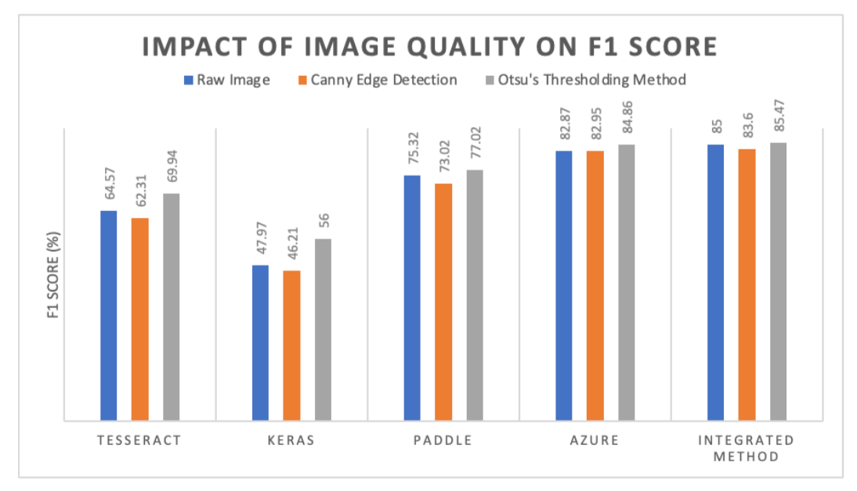
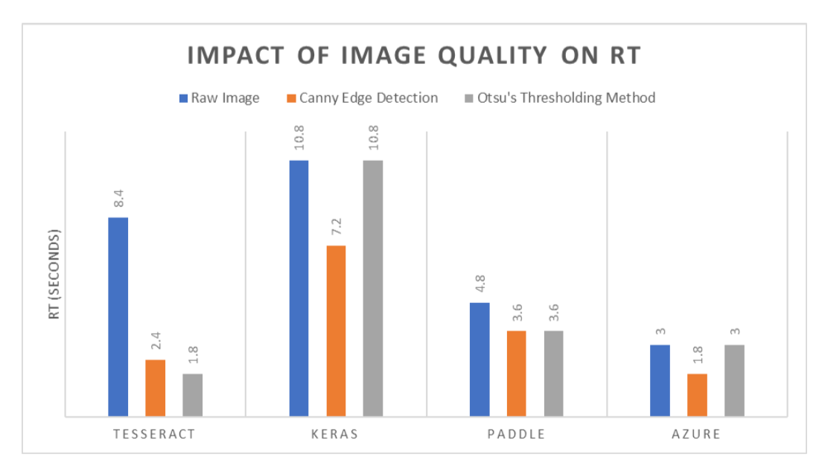
Image Pre-processing and Quality
Integrated System marginally superior performance
All OCR except for Paddle perform worse in Canny Edge Images
General Improvement of All OCR on Otsu’s Thresholding Images with Tesseract and Keras benefiting the most
Edge detection reduces the OCR processing time due to simplified image dimensionality and complexity
Notes:
when tested on the IAM Printed dataset. The data indicates that the Integrated System exhibits a marginally superior performance compared to the other OCR engines.
the Canny edge detection method, results in a general performance decline across all OCR engines. However, Paddle shows a slight improvement, while Azure and the Integrated Method are less impacted, indicating their robustness to image quality fluctuations, possibly due to their underlying architectures designed to be less sensitive to input noise and variance.
Otsu’s thresholding method positively impacts performance metrics across all OCR engines, with Tesseract and Keras exhibiting the most substantial gains. This improvement may stem from the method’s binary thresholding process, which reduces input variability and simplifies character recognition, particularly for engines that might struggle with nuanced grayscale values such as Tesseract and Keras.
Edge detection and Thresholding reduces the OCR processing time due to binarization and noise reduction that simplify the image’s dimensionality and complexity.

Slide 22
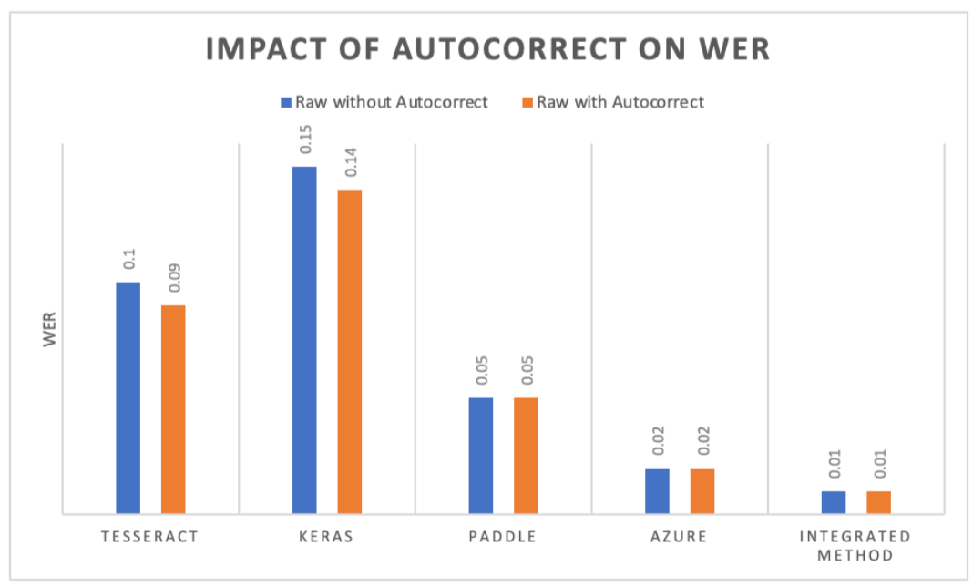
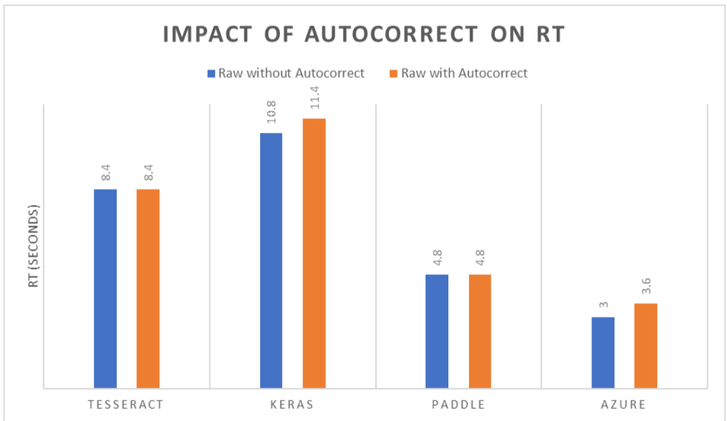
Autocorrect
Moderately beneficial, particularly in reducing the Word Error Rate (WER)
Impact of autocorrect is more pronounced for Keras and Tesseract than others
Increase the processing time by approximately 0.6 seconds per image
Notes:
Autocorrect features prove to be moderately beneficial, particularly in reducing the Word Error Rate (WER), but do not substantially influence other metrics. Notably, the impact of autocorrect is more pronounced for Keras and Tesseract compared to Paddle, Azure, and the Integrated System. This differential effect is due to that Keras and Tesseract relies on exact character matches, which are more prone to error without the assistance of a context-aware autocorrect system.

Slide 23
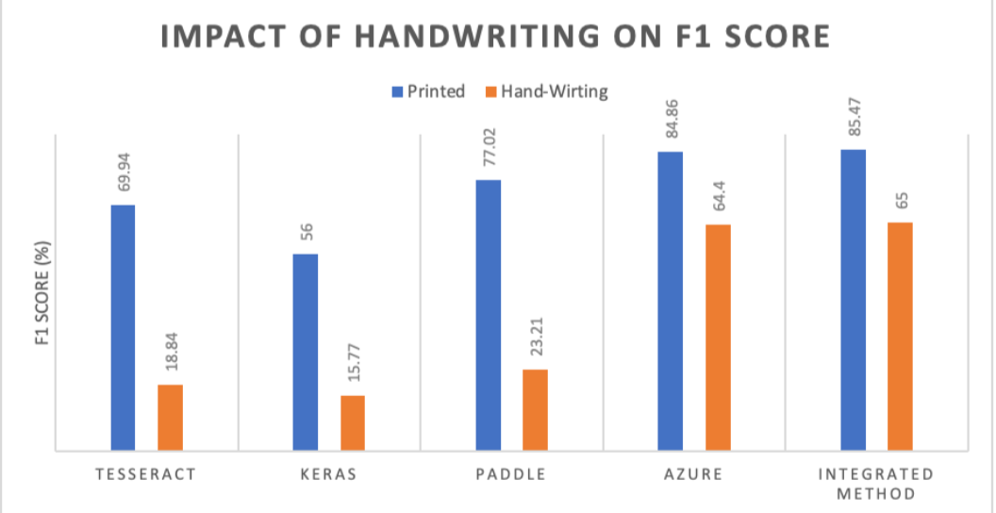
Handwriting Recognition
All OCR engines tend to perform a lot less effectively on handwritten text compared to printed text
Tesseract shows the largest drop in performance, while Azure exhibits the smallest disparity.
OCR works by pattern recognition which is easier for printed text recognition but handwriting typically lacks consistent patterns
Notes:
It shows that all OCR engines tend to perform a lot less effectively on handwritten text compared to printed text. Tesseract shows a significant difference in performance, with a much higher F1 score for printed text. Azure OCR exhibits a relatively smaller disparity between printed and handwritten text performance.
This disparity is primarily because OCR works by pattern recognition which is easier for printed text recognition. However, human handwriting, especially in cursive form, typically lacks consistent patterns. They are usually more diverse and complex, often have variations in character shapes, sizes, and spacings, which challenges the pattern recognition capabilities of general OCR technologies.
The reason why Azure OCR stands out in handwriting recognition is because it has employed sophisticated techniques like Intelligent Character Recognition (ICR), which is specifically designed to handle the complexities of handwritten characters and cursive writing.

Slide 24
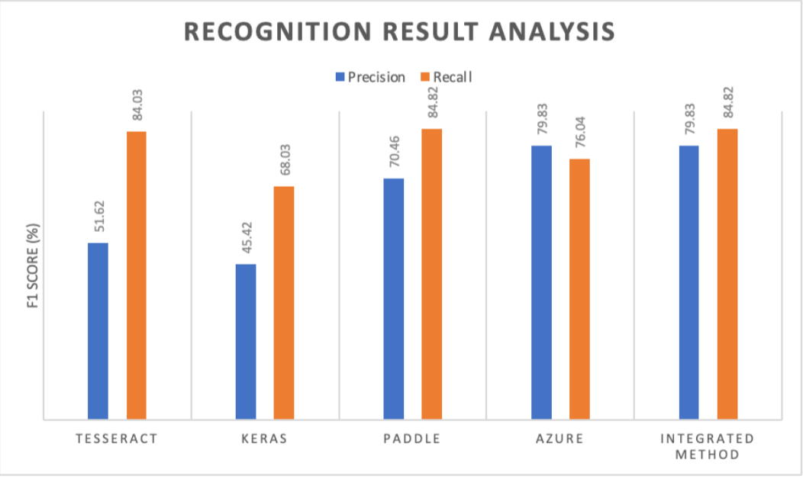
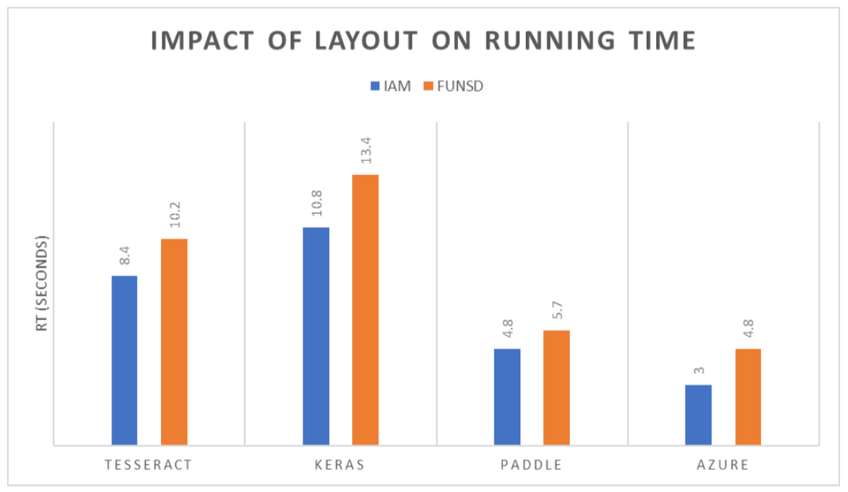
Impact of Form Understanding
Tesseract and Keras, exhibiting high recall but low precision, suggest a tendency to overgeneralize.
Azure demonstrates high precision with slightly lower recall.
Clearer difference in OCR models’ capabilities when dealing with complex documents like those in the FUNSD dataset.
Increased running time is attributed to the complex layouts and lower image quality in FUNSD Data
Notes:
Tesseract and Keras, exhibiting high recall but low precision, suggest a tendency to overgeneralize. This means they identify the most relevant text (high recall) but also incorrectly classify irrelevant elements as text (low precision), resulting in numerous false positives.
In contrast, Azure demonstrates high precision with slightly lower recall. This im- plies that while it accurately identifies relevant text (high precision), it may miss some relevant instances (lower recall).
OCR technology is sensitive to image quality, and when faced with low-resolution, poorly lit, or low-contrast images, its text recognition capability is significantly diminished. Additionally, OCR struggles with documents that have complex or unconventional layouts, such as multiple columns or embedded graphical elements. These complexities require more advanced processing, which can increase the time needed for accurate text recognition.

Slide 25
Conclusion and Future Work

Slide 26
Conclusion
OCR model performance can be improved by reducing the complexity of the input images.
Autocorrect features introduces a modest enhancement in reducing the Word Error Rate (WER), yet it introduces extra processing time for all OCR
Synergizing OCR engines via integrated scoring system can outperform individual OCR models
Notes:
1. OCR model performance can be improved by reducing the complexity of the input images.
The impact of pre-processing techniques such as Otsu’s thresholding is notably significant, especially for Tesseract and Keras.
Improvement is not universally applicable, as evidenced by the Integrated Method’s consistent performance irrespective of such pre-processing, indicating a possible intrinsic optimization within its composite algorithms.
2. Autocorrect features introduces a modest enhancement in reducing the Word Error Rate (WER), yet it introduces extra processing time for all OCR
This increment suggests a diminishing return for engines already equipped with advanced error-correction capabilities, pointing to a potential redundancy of the autocorrect step in such sophisticated systems.
3. Synergizing OCR engines via integrated scoring system can outperform individual OCR models
Integrated System as the superior method across various settings, demonstrating exceptional robustness and consistently high performance across various preprocessing conditions and datasets.

Slide 27
Future Work
OCR Fine-tuning： fine-tune OCR models using transfer-learning for specific tasks.
Contextual Analysis: incorporating NLP techniques for post-processing could enable the system to consider the context of words, reducing the chance of selecting out-of-context words
Intelligent Character Recognition (ICR): harnesses the collective strength of artificial intelligence (AI), machine learning (ML), and natural language processing (NLP) to understand their context and variations in handwriting styles and not just pattern recognition in OCR.

Slide 28
Q&A
Notes:
So that’s the key extraction I want to present in my capstone project. Any Questions are welcomed.

Slide 29
References
[1] Saptak Chakraborthy. Intelligent character recognition vs ocr: Overcoming ocr limitations in document processing, Nov 2023.
[2] Honglie Chen, Weidi Xie, Andrea Vedaldi, and Andrew Zisserman. Autocor- rect: Deep inductive alignment of noisy geometric annotations. arXiv preprint arXiv:1908.05263, 2019.
[3] YuningDu,ChenxiaLi,RuoyuGuo,XiaotingYin,WeiweiLiu,JunZhou,Yifan Bai, Zilin Yu, Yehua Yang, Qingqing Dang, and Haoshuang Wang. Pp-ocr: A practical ultra lightweight ocr system, 2020.
[4] Jean-Philippe Thiran Guillaume Jaume, Hazim Kemal Ekenel. Funsd: A dataset for form understanding in noisy scanned documents. In Accepted to ICDAR-OST, 2019.
[5] Maya R Gupta, Nathaniel P Jacobson, and Eric K Garcia. Ocr binarization and image pre-processing for searching historical documents. Pattern Recognition, 40(2):389–397, 2007.
[6] Karez HAMAD and Mehmet KAYA. A detailed analysis of optical character recognition technology. International Journal of Applied Mathematics Electron- ics and Computers, (Special Issue-1):244–249, 2016.
[7] SantoshKumarHengeandB.Rama.Comprativestudywithanalysisofocralgo- rithms and invention analysis of character recognition approched methodologies. In 2016 IEEE 1st International Conference on Power Electronics, Intelligent Con- trol and Energy Systems (ICPEICES), pages 1–6, 2016.
[8] Aravind Inbasekaran, Rajesh Kumar Gnanasekaran, and Richard Marciano. Us- ing transfer learning to contextually optimize optical character recognition (ocr) output and perform new feature extraction on a digitized cultural and historical dataset. In 2021 IEEE International Conference on Big Data (Big Data), pages 2224–2230. IEEE, 2021.
[9] Guillaume Jaume, Hazim Kemal Ekenel, and Jean-Philippe Thiran. Funsd: A dataset for form understanding in noisy scanned documents. In 2019 Interna- tional Conference on Document Analysis and Recognition Workshops (ICDARW), volume 2, pages 1–6, 2019.
[10] RenukaKajale,SoubhikDas,andParitoshMedhekar.Supervisedmachinelearn- ing in intelligent character recognition of handwritten and printed nameplate. In 2017 International Conference on Advances in Computing, Communication and Control (ICAC3), pages 1–5. IEEE, 2017.
[11] Yuliia Kniazieva. Intelligent character recognition, Aug 2023.
[12] Devashree Madhugiri. Extract text from images quickly using keras-ocr pipeline, Apr 2023.
[13] HR Mamatha and K Srikantamurthy. Morphological operations and projection profiles based segmentation of handwritten kannada document. International Journal of Applied Information Systems (IJAIS), 4(5):13–19, 2012.
[14] U-V Marti and H Bunke. The iam-database: An english sentence database for off-line handwriting recognition. International Journal on Document Analysis and Recognition, 5:39–46, 2002.
[15] AndrewMorris,ViktoriaMaier,andPhilGreen.Fromwerandriltomerandwil: improved evaluation measures for connected speech recognition. 01 2004.
[16] James Mutinda, Waweru Mwangi, and George Okeyo. Lexicon-pointed hybrid n-gram features extraction model (lenfem) for sentence level sentiment analysis. Engineering Reports, 3(8):e12374, 2021.
[17] Ram Sarkar, Nibaran Das, Subhadip Basu, Mahantapas Kundu, and Mita Nasipuri. Extraction of text lines from handwritten documents using piecewise water flow technique. Journal of Intelligent Systems, 23(3):245–260, 2014.
[18] Snehil Saxena, Sidharth Jain, Saurabh Tripathi, and Kapil Gupta. Comparative analysis of image segmentation techniques. In Advances in Communication and Computational Technology: Select Proceedings of ICACCT 2019, pages 317–331. Springer, 2021.
[19] Steven Simske. Parallel processing considerations for image recognition tasks. HP Laboratories Technical Report, 01 2011.
[20] Ray Smith. An overview of the tesseract ocr engine. In Proc. Ninth Int. Confer- ence on Document Analysis and Recognition (ICDAR), pages 629–633, 2007.
[21] WilliamUghettaandBrianW.Kernighan.Theoldbaileyandocr:Benchmarking aws, azure, and gcp with 180,000 page images. Proceedings of the ACM Sympo- sium on Document Engineering 2020, 2020.
[22] William Ughetta and Brian W. Kernighan. The old bailey and ocr: Benchmark- ing aws, azure, and gcp with 180,000 page images. In Proceedings of the ACM Symposium on Document Engineering 2020, DocEng ’20, New York, NY, USA, 2020. Association for Computing Machinery.
[23] J.P. Woodard and year = 1982 journal = Workshop on standardisation for speech I/O technology, Naval Air Development Center, Warminster, PA title = An infor- mation theoretic measure of speech recognition performance Nelson, J.T.
[24] Fangsheng Wu, Changan Zhu, Jinxiu Xu, Mohammed Wasim Bhatt, and Ashutosh Sharma. Research on image text recognition based on canny edge detec- tion algorithm and k-means algorithm. International Journal of System Assurance Engineering and Management, pages 1–9, 2021.
[25] Zhao Xu, Xu Baojie, and Wu Guoxin. Canny edge detection based on open cv. In 2017 13th IEEE International Conference on Electronic Measurement Instru- ments (ICEMI), pages 53–56, 2017.

Slide 30
Appendix

Slide 31
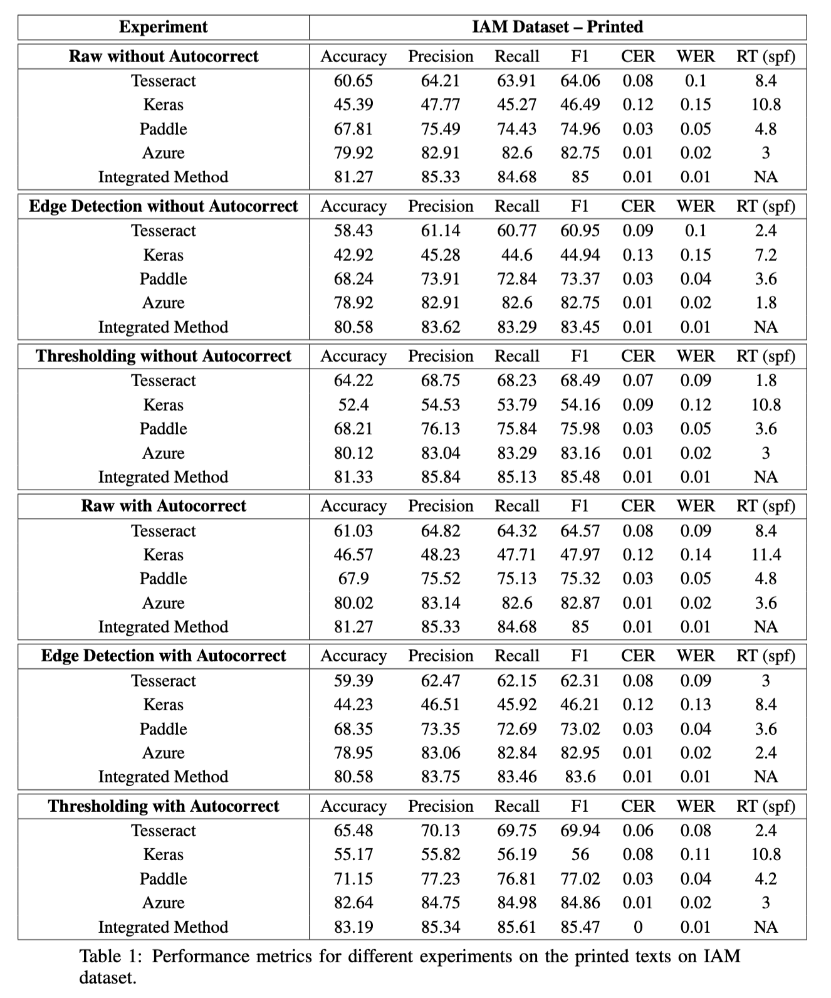
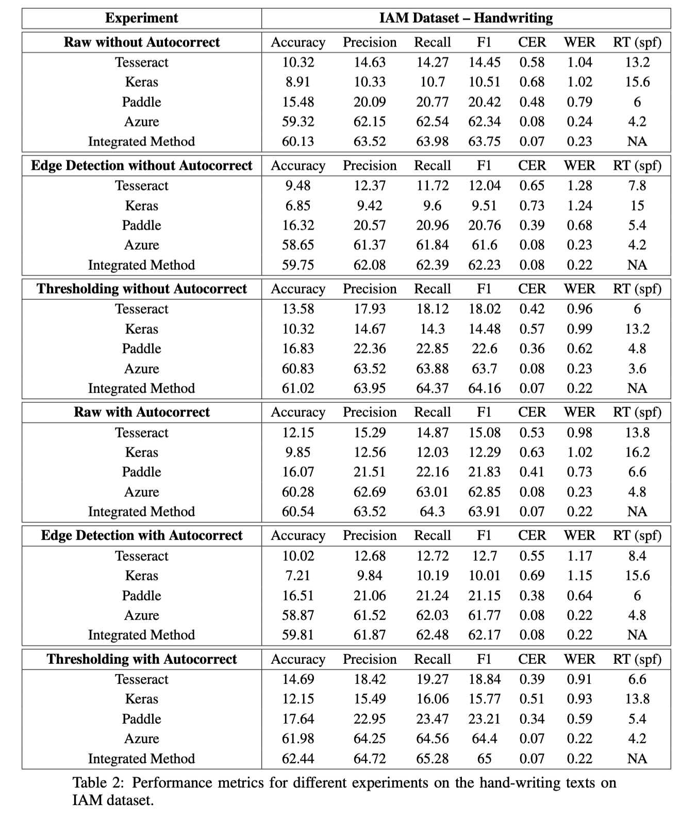

Slide 32
